Slide 1




Path-Way-Services
Ullash Bhattacharjee 180104103
Mostafizur Rahman 180104112
Kaho Fardin Hasib 170204063
Presenter
Ullash Bhattacharjee 180104103

Slide 2
Data Flow Diagram : Activities of the project
User Account (User, Administrator)
Login page & Registration Page
Password Recovery Page For Users
Users profile section
Check seats for available transports according to the route & date
Booking or cancel Ticket
Contact section with the admin
Add new route, remove or update Route Information
Add new transport or remove transport
Handle pending tickets

Slide 3
Name of Process, Entity & DB:
Process : Authentication , Communication , Login , Registration , Profile (Manage profile , Edit Profile) , Manage Transport(Adding , Remove) , Manage Route (Adding , Update , Remove) , Manage Ticket(Pending).
Entities : Admin, User, Route , Bus- Schedule, Transaction , Seat-Information .
Databases : Single database where store every kinds of entities information .

Slide 4
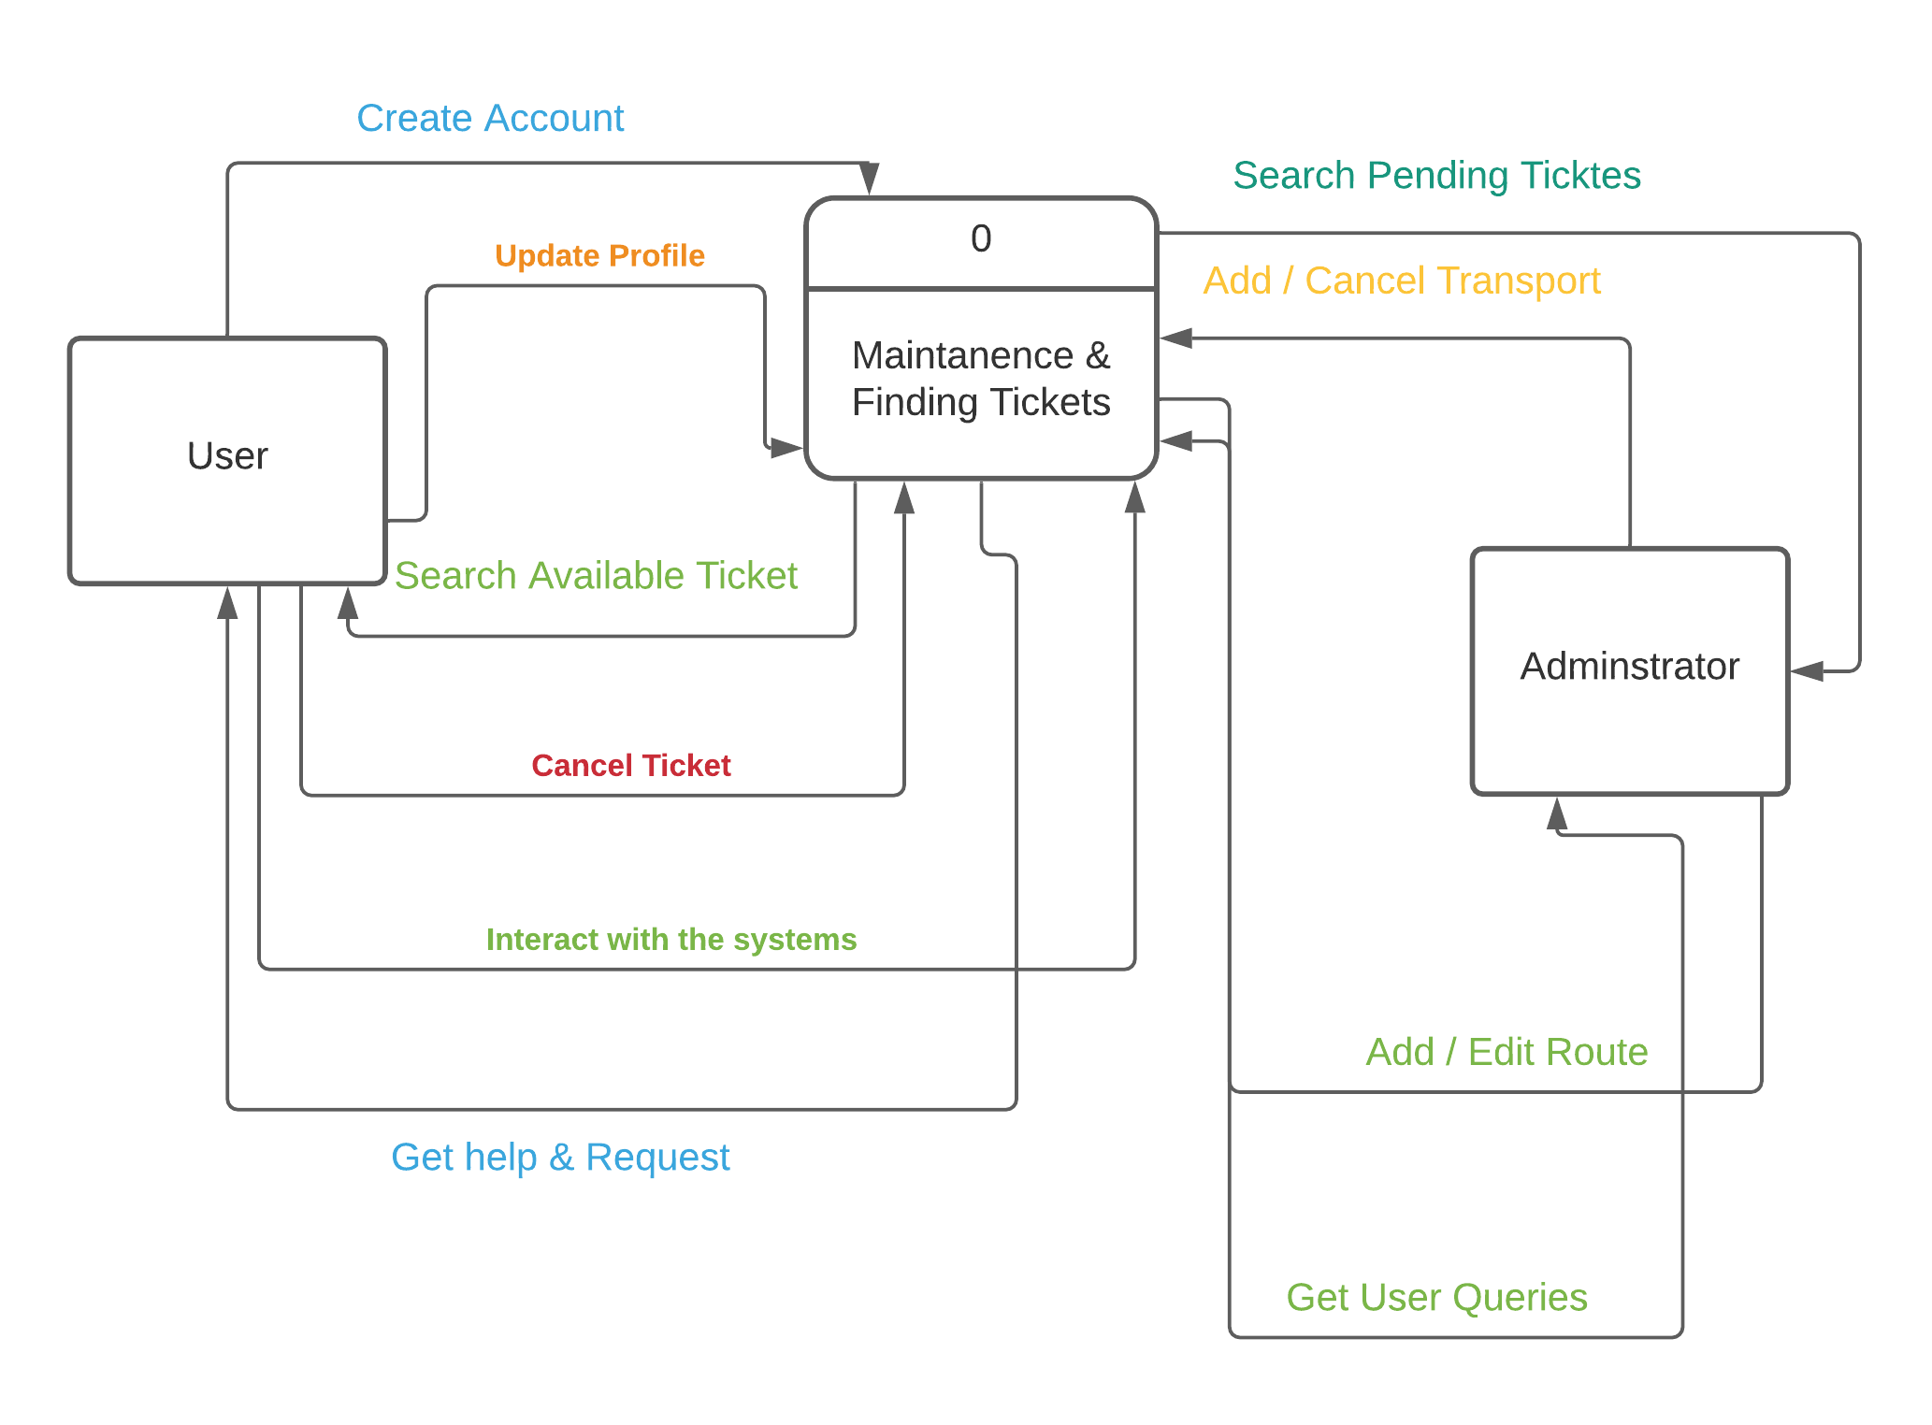
Construction Of The Context Level Diagram:
Figure: Level 0 Diagram

Slide 5
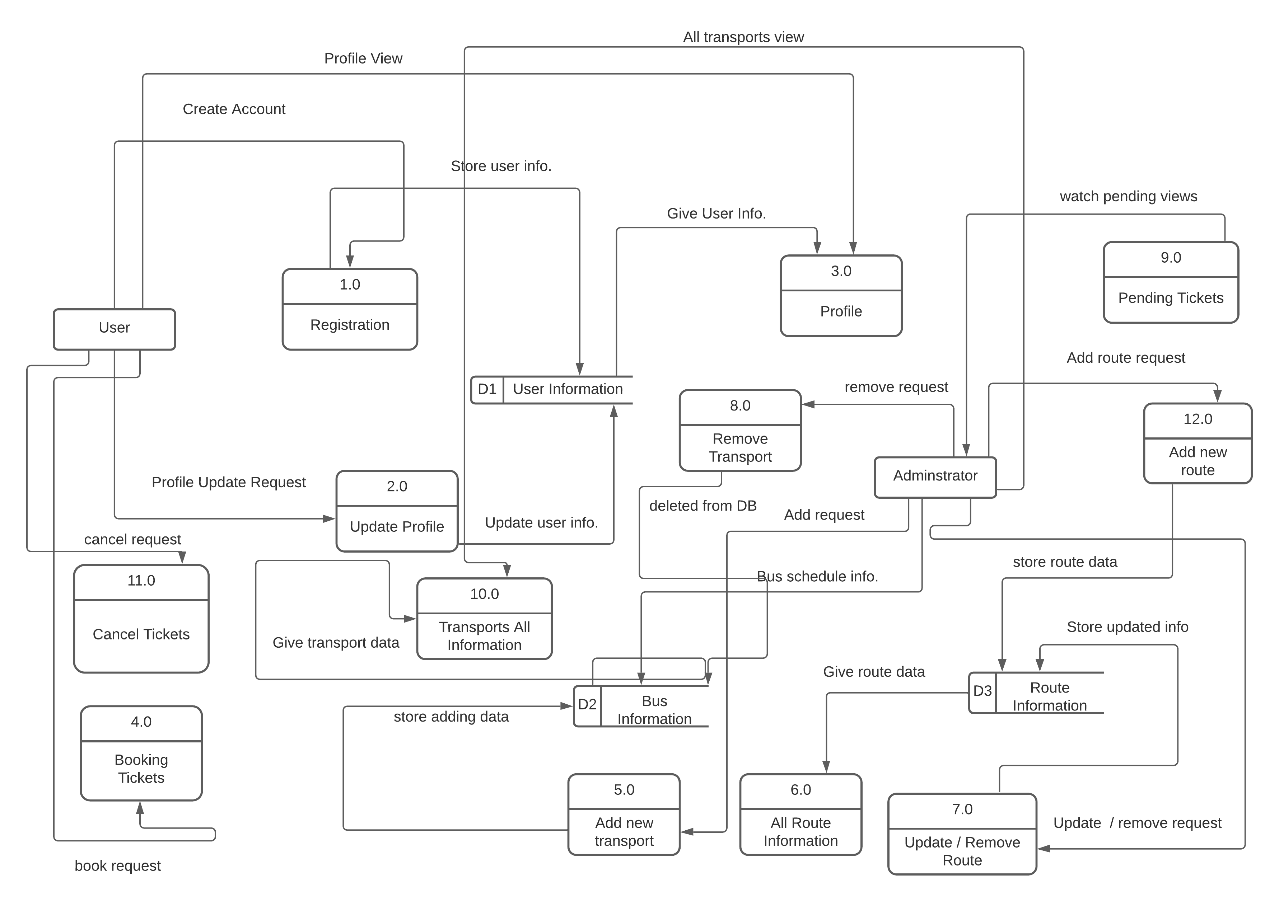
Construction Of Level 1 Diagram:
Figure: Level 1 Diagram

Slide 6
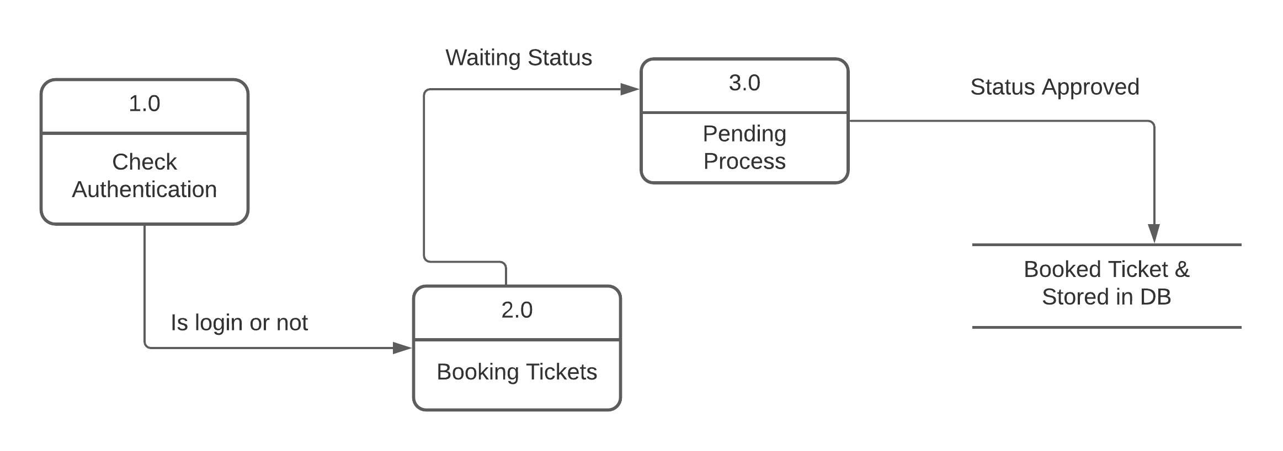
Construction Of Level 2 Diagram:
Figure: Level 2 Diagram

Slide 7
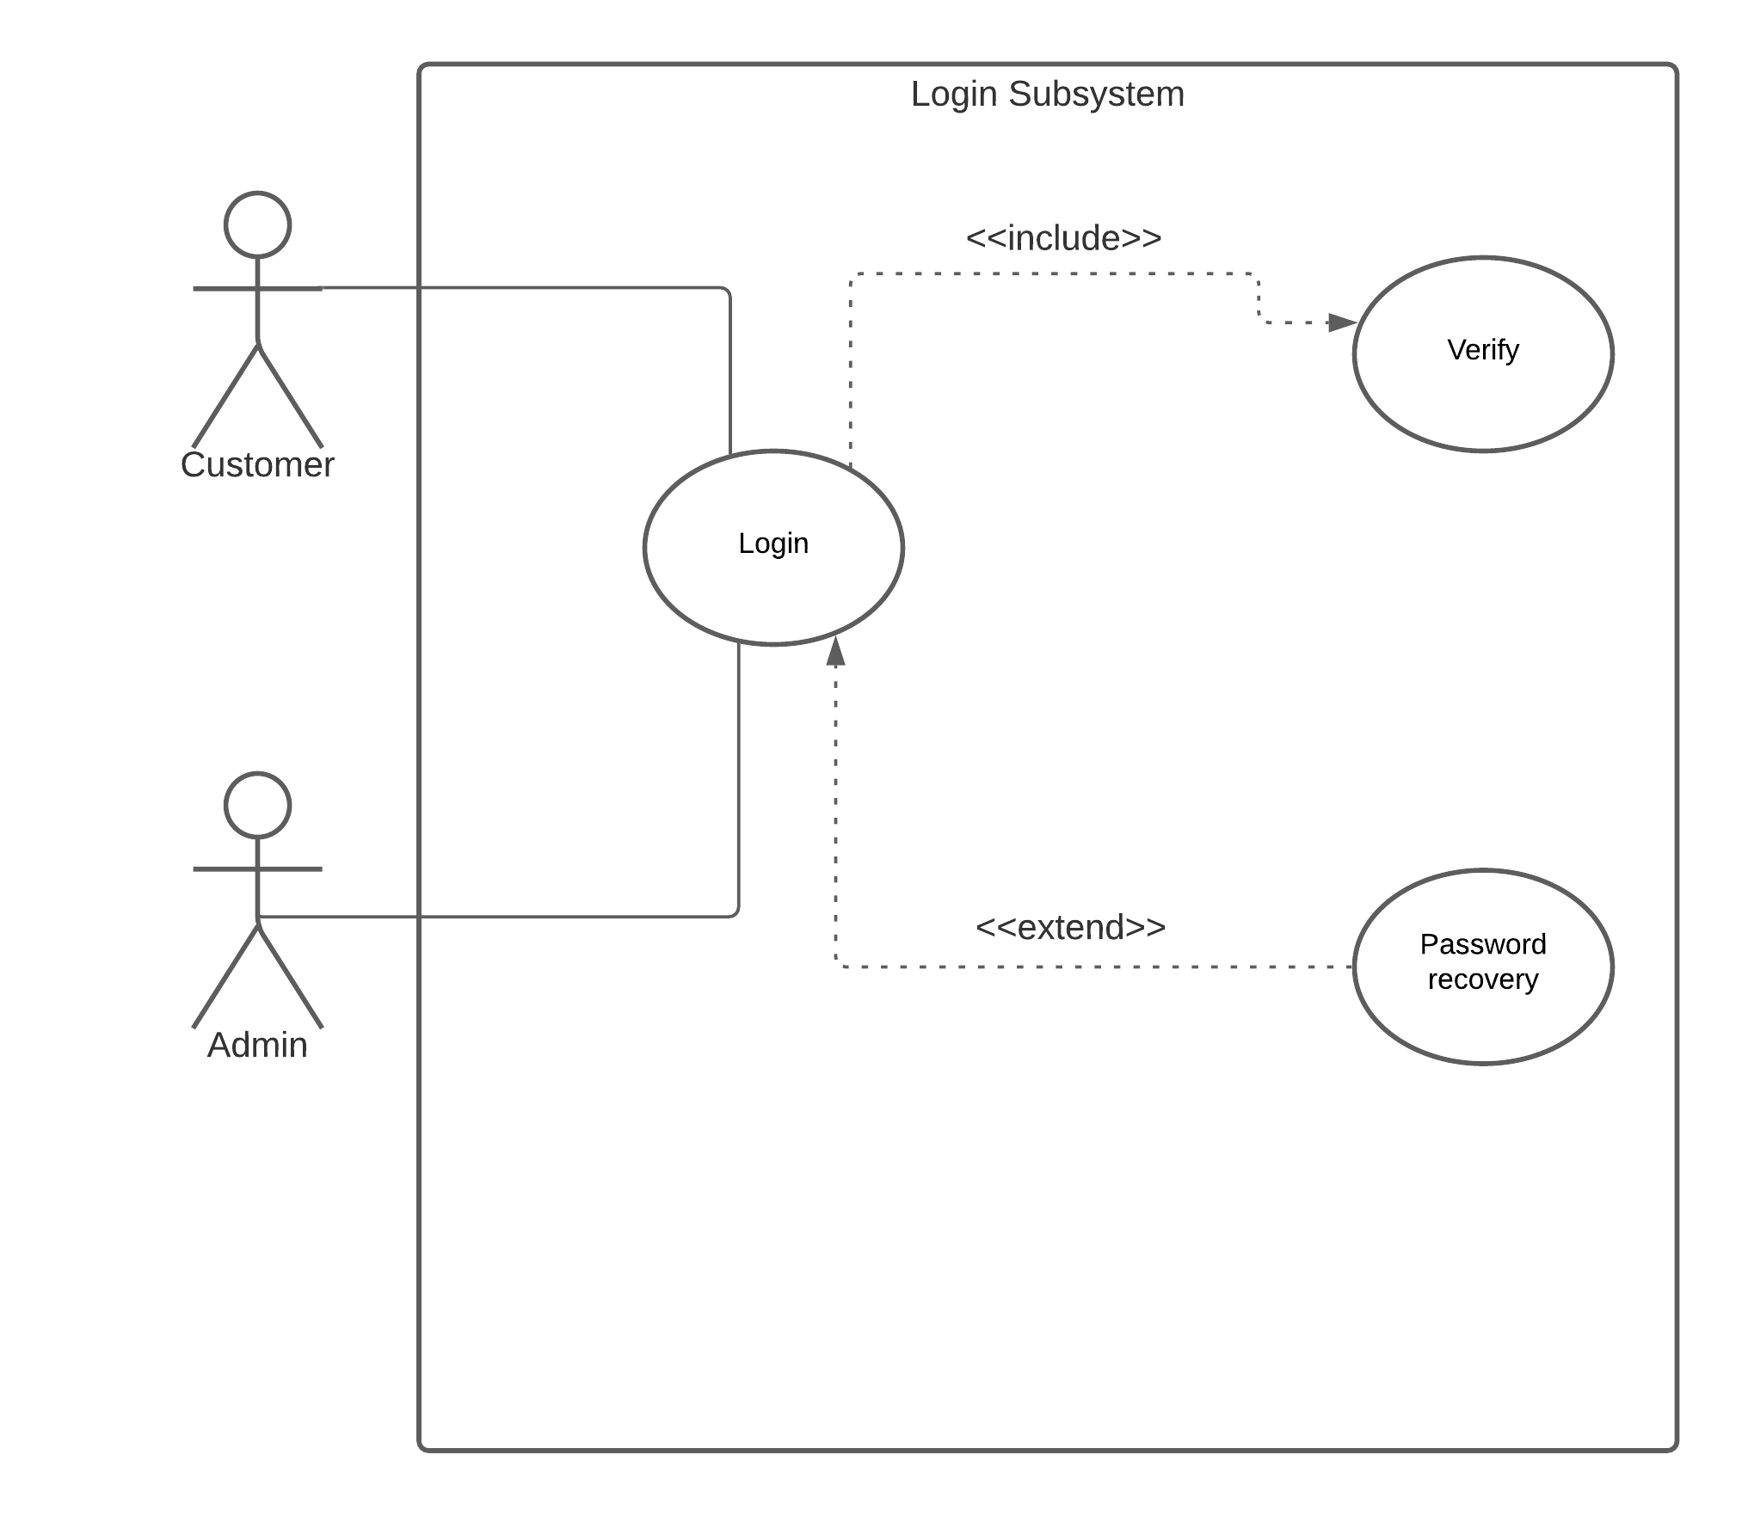
Use Case Diagram:
Actors: Admin, User.
Use Cases: Login Subsystem
Figure: Login Subsystem Diagram

Slide 8
Use Case Narrative:
Use Case Title: | Login.
Primary Actor: | User , Admin.
Goal in Context: | To Register and get username and password for login and get access our website.
Precondition: | Must have to be member by registration and get username for login.
Scenario: | From login page user have to login into the system.
Exception: | Login with correct password or recovery password.
Priority: | High priority.
Channel to actor: | PC – Browser.

Slide 9
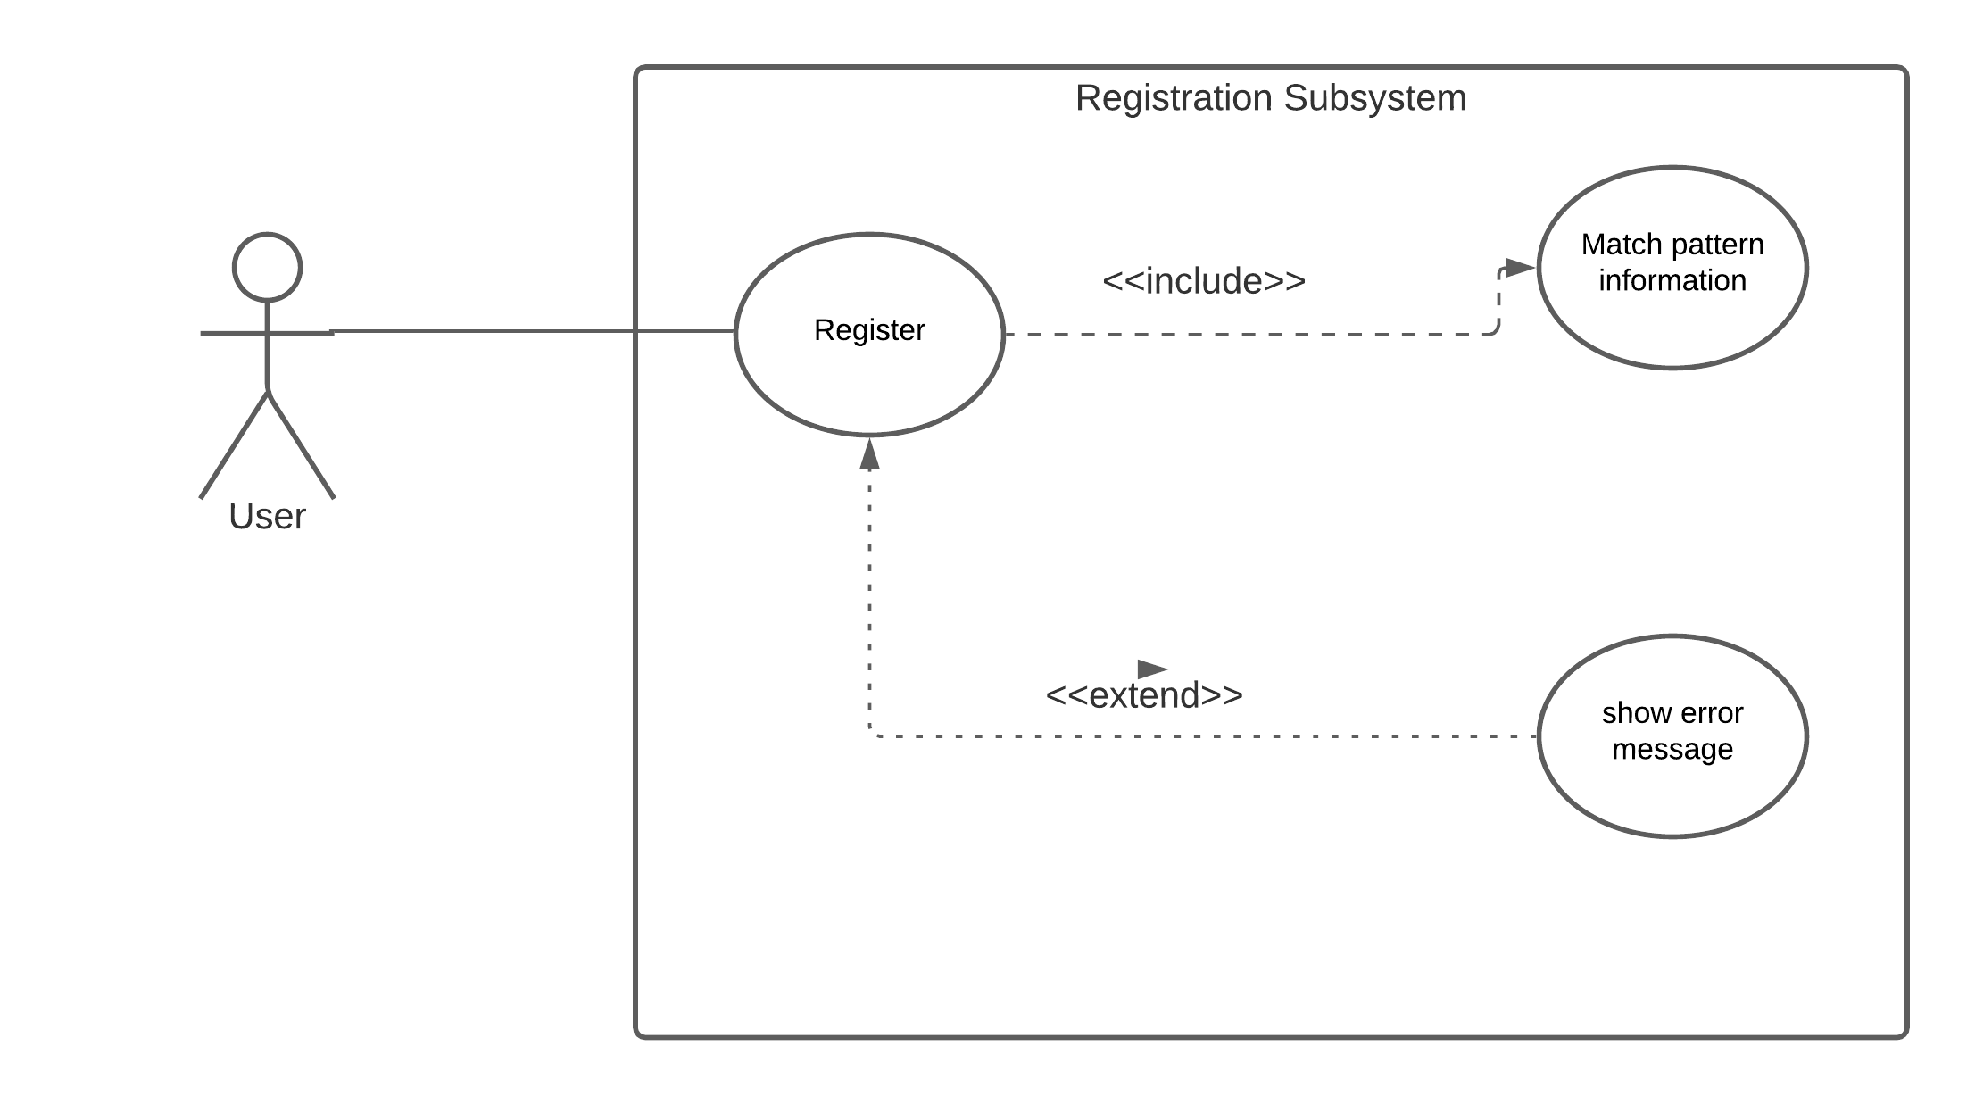
Use Case Diagram:
Actors: Non- User.
Use Cases: Registration Subsystem.
Figure: Registration Subsystem Diagram

Slide 10
Use Case Narrative:
Use Case Title: | Registration Subsystem.
Primary Actor: | Non - User.
Goal in Context: | To Login and access the website.
Precondition: | Non users should click on the sign up button filling all the information to be regular user.
Scenario: | From registration page non - user can find some text field to fill their information.
Priority: | Low priority (depends on customer mind).
Channel to actor: | PC – Browser.

Slide 11
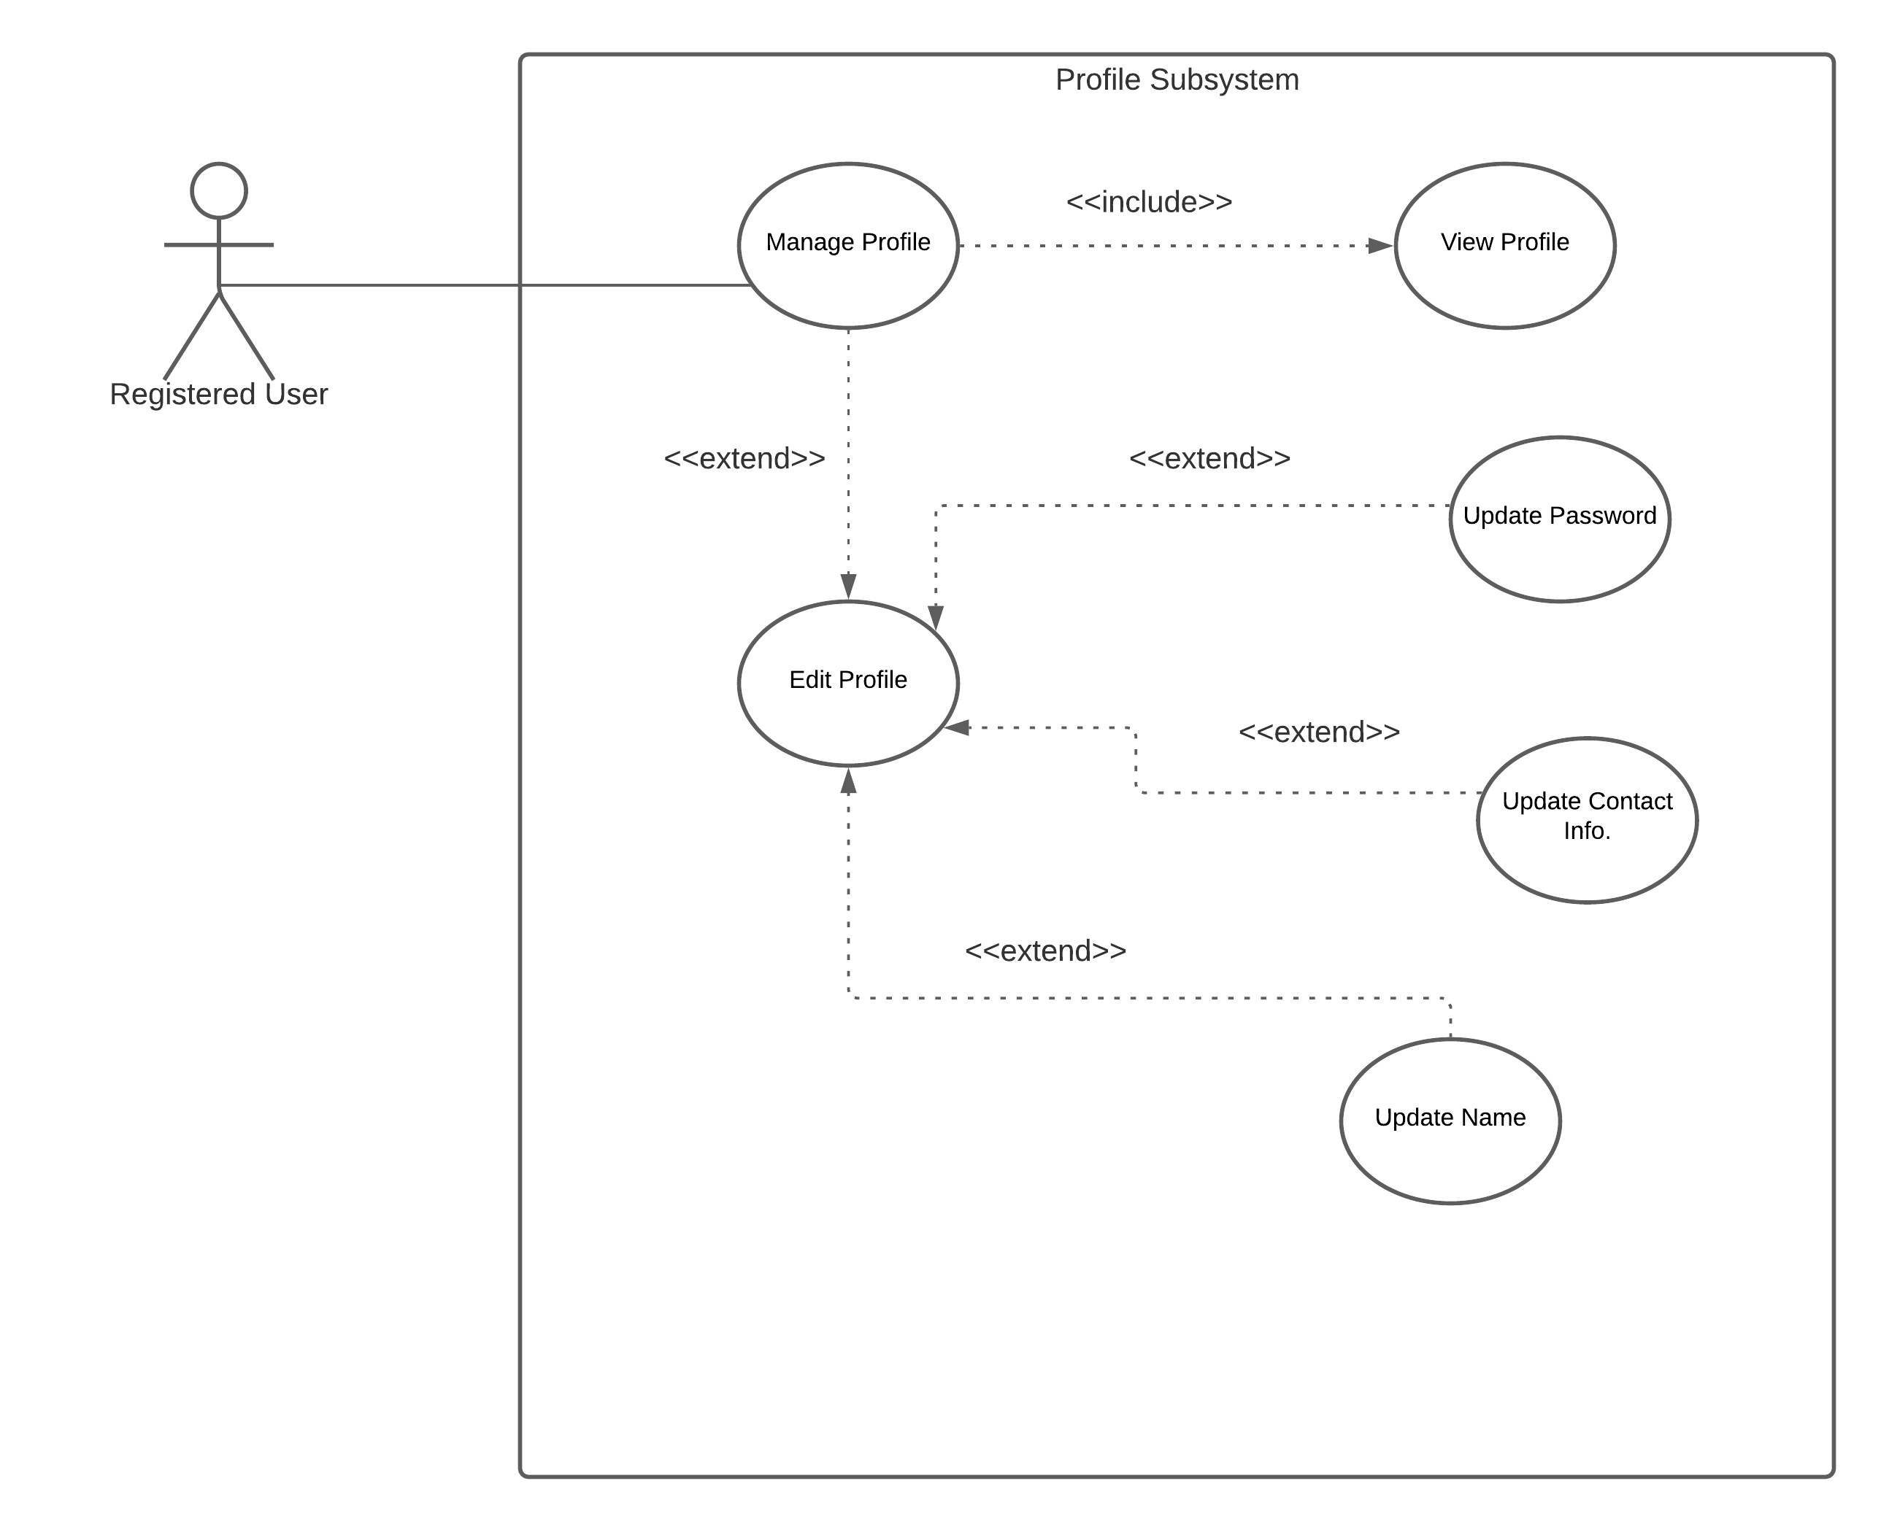
Use Case Diagram:
Actors: User.
Use Cases: Profile Subsystem (manage profile, edit profile).
Figure: Profile Subsystem Diagram

Slide 12
Use Case Narrative:
Use Case Title: | Manage Profile.
Primary Actor: | User.
Goal in Context: | To watch “my profile” information.
Precondition: | Must have an account to the website.
Scenario: | Users can watch their detail information.
Priority: | High priority.
Channel to actor: | PC – Browser.
Use Case Title: | Edit Profile.
Primary Actor: | User.
Goal in Context: | To edit profile section.
Precondition: | Must have an account to the website.
Scenario: | Users can watch some text field to update their information.
Priority: | Low priority.
Channel to actor: | PC – Browser.

Slide 13
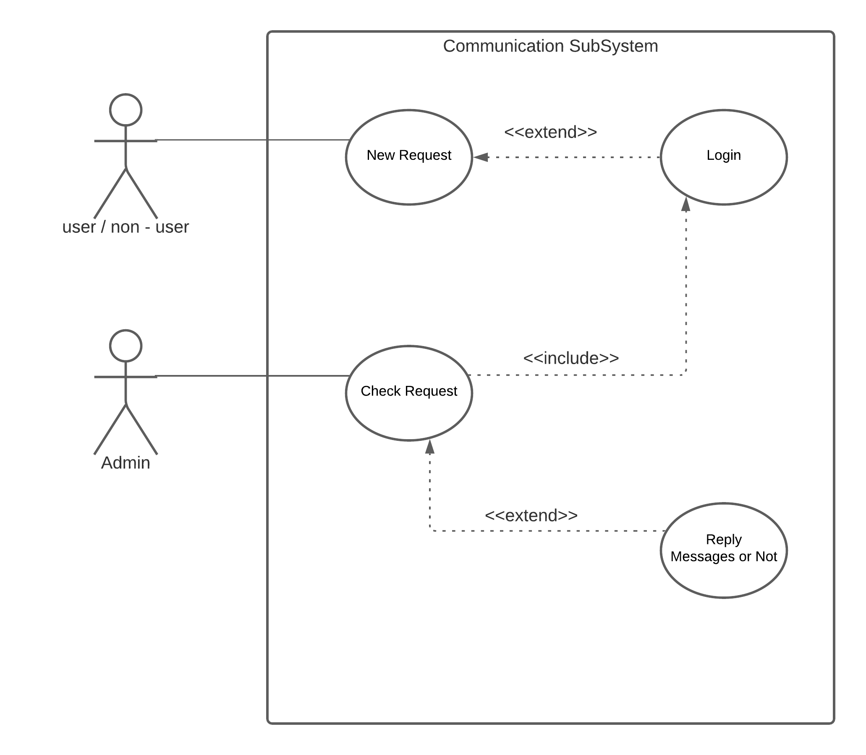
Use Case Diagram:
Actors: User, Non-User.
Use Cases: Communication Subsystem.
Figure: Communication Subsystem Diagram

Slide 14
Use Case Narrative:
Use Case Title: | Communication.
Primary Actor: | User, Non User.
Goal in Context: | To contact with the admin for giving feedback or knowing something.
Scenario: | Showing a contact page with some text field and a button to send the message.
Priority: | Medium priority.
Channel to actor: | PC – Browser.

Slide 15
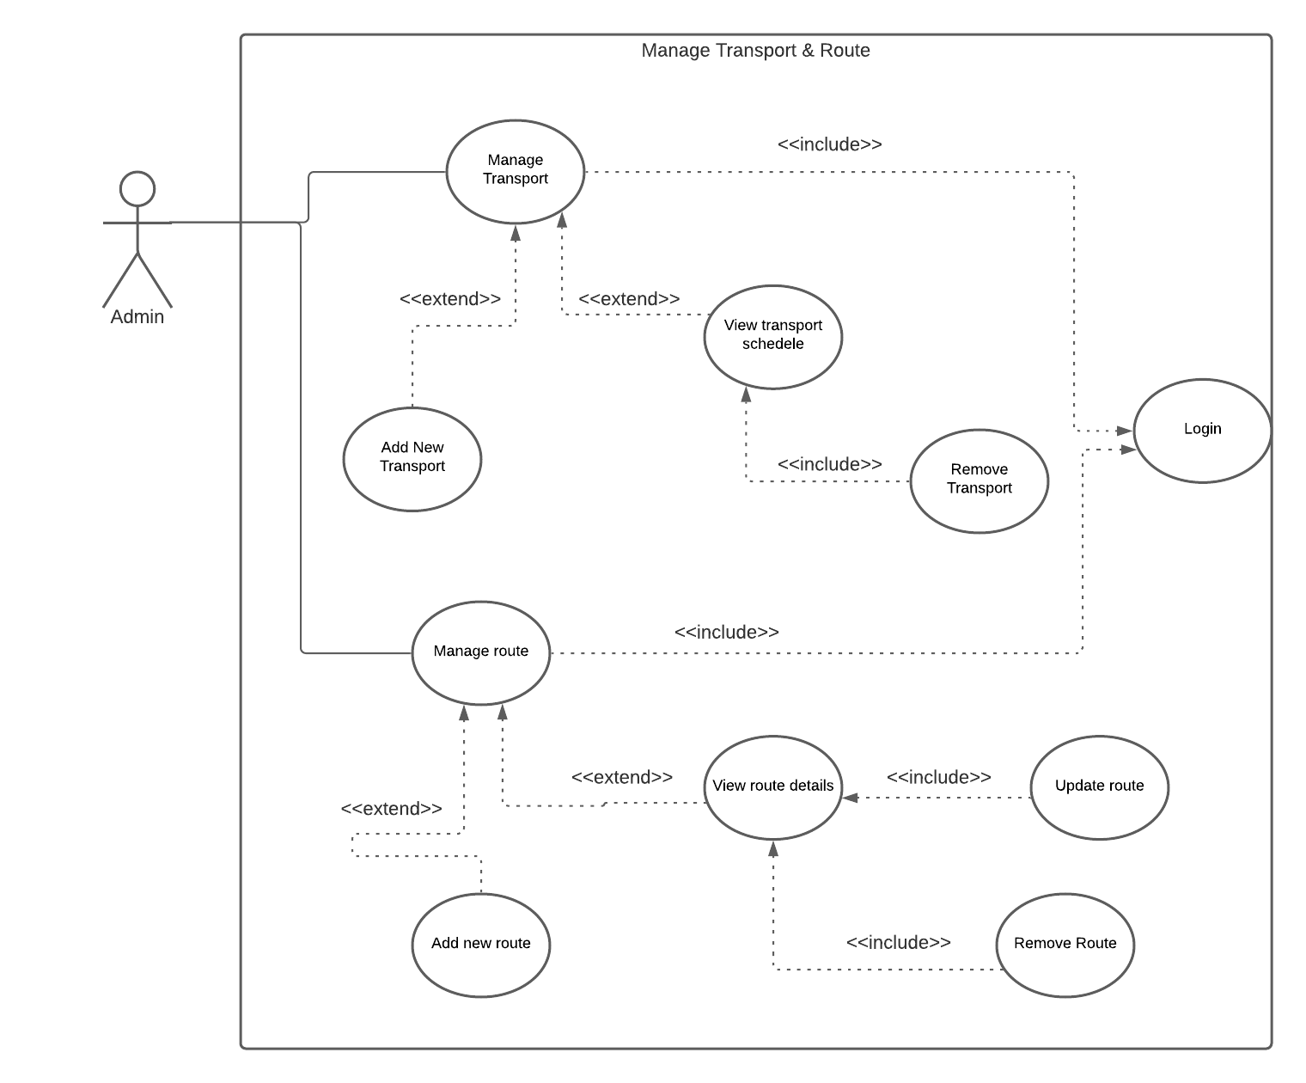
Use Case Diagram:
Actors: Admin.
Use Cases: Manage System(Transport & Route).
Figure: Manage System (Transportation & Route) Diagram .

Slide 16
Use Case Narrative:
Use Case Title: | Manage Transport.
Primary Actor: | Admin.
Goal in Context: | To manage transports every feature related to the E-Ticketing Service.
Precondition: | Must have an account to configure.
Scenario: | From manage page admin can add , remove new transport , transports schedule , users pending tickets etc.
Priority: | High priority
Channel to actor: | PC – Browser.
Use Case Title: | Manage Route.
Primary Actor: | Admin
Goal in Context: | To manage newly added route.
Precondition: | Must have an account to configure.
Scenario: | From manage page admin can add, remove or update new route.
Priority: | High priority
Channel to actor: | PC – Browser.

Slide 17
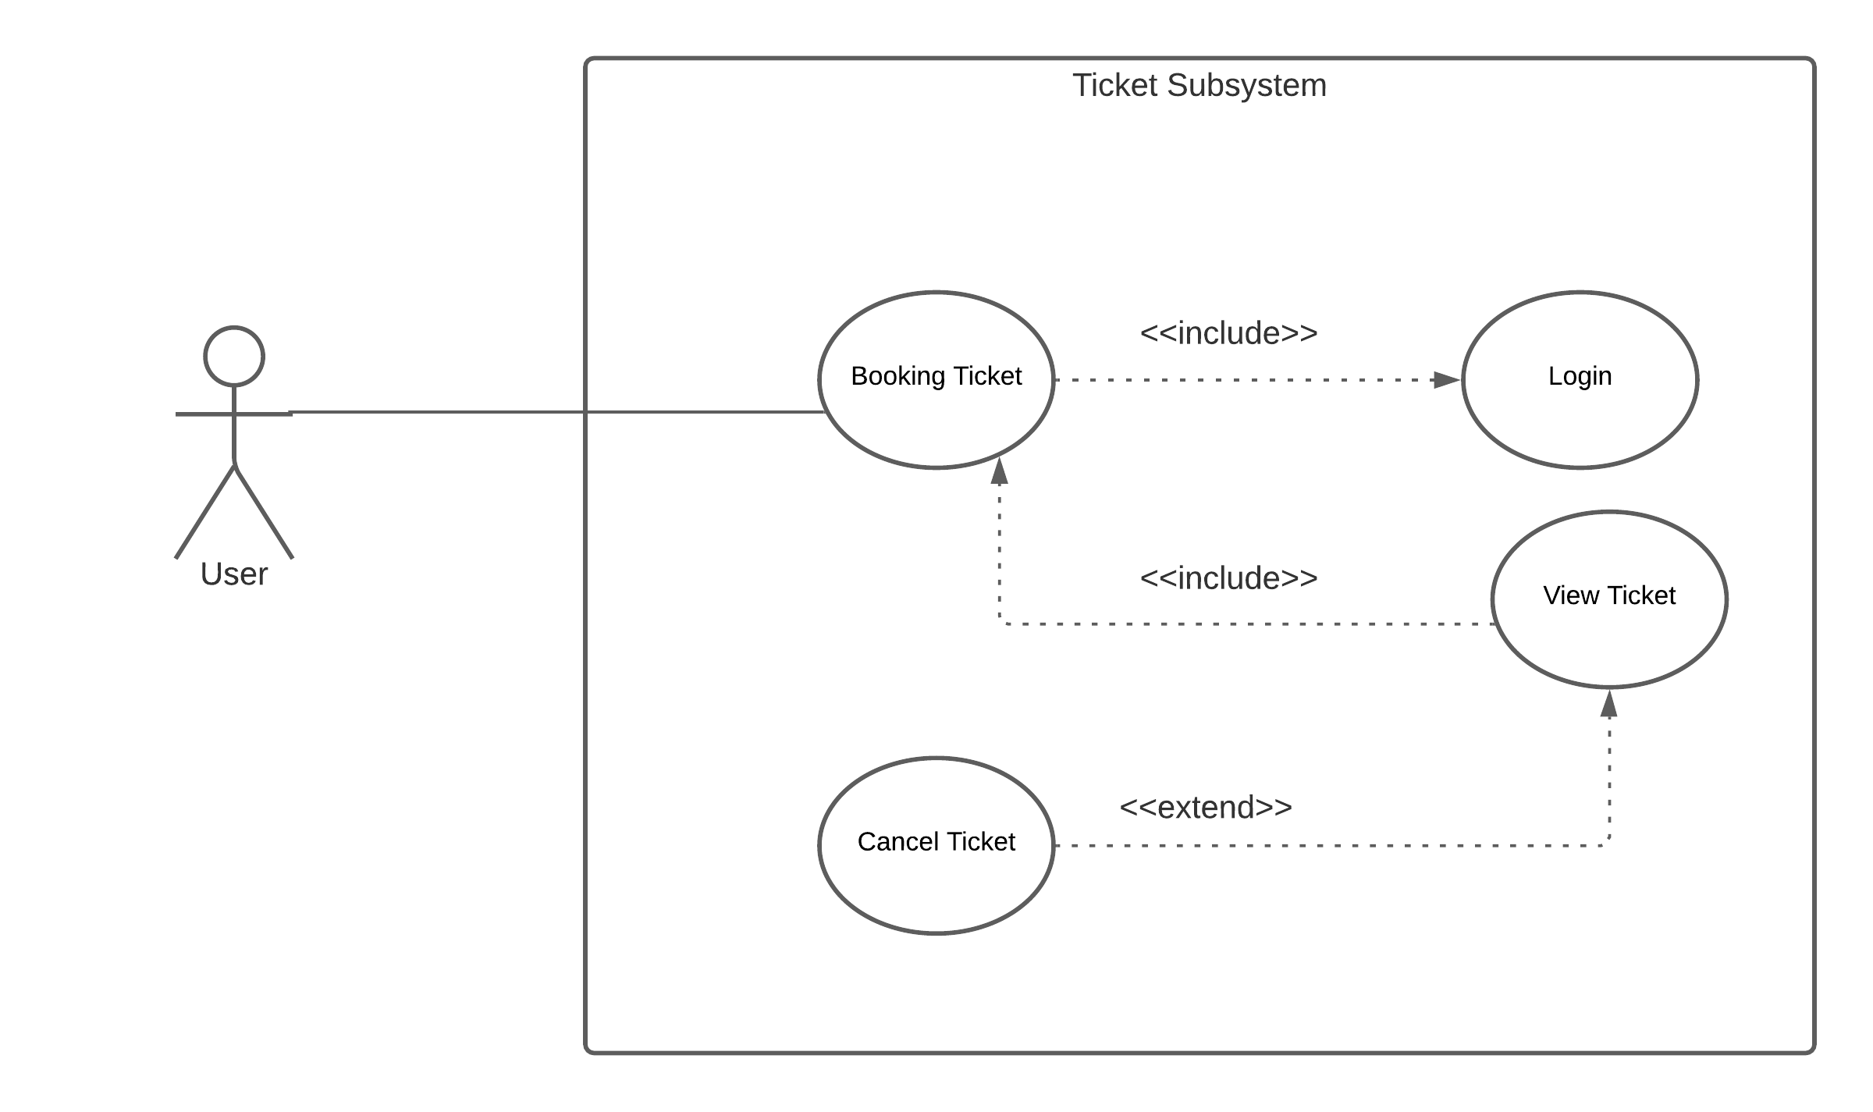
Use Case Diagram:
Actors: User.
Use Cases: Manage Ticket Subsystem.
Figure: Ticket Subsystem Diagram .

Slide 18
Use Case Narrative:
Use Case Title: | Manage Ticket.
Primary Actor: | User.
Goal in Context: | To book or cancel tickets.
Precondition: | User must have an account.
Scenario: | From this page, user can book ticket or cancel ticket.
Priority: | High Priority.
Channel to actor: | PC – Browser.

Slide 19

Conclusion
By using Data Flow Diagram and Use case we can have an overall view of the whole project. Since data flow diagram (DFD) is a visual representation of the information flow through a process or system and Use-case diagram describe the high-level functions and scope of a system as a result both diagrams make it much more easier to understand and helps us to make a proper structure for this project. It also helps us to identify what is most important for our project. So building a DFD and Use-case for our project is a very important and a fundamental procedure.

